Slide 1

AI WRITES CODE — But Who Checks It?
TEAM 08
Dao Trong-Nghia (daotro01)
Mata Marco (matamar)
Kott Jan (kottjan1)
Galindo Lopez Pablo Emiliano (galinpab)
ADVANCED SOFTWARE ENGINEERING
(Frühlingssemester 2026)

Slide 2

AGENDA
Main results of Task 1
01
Main results of Task 2
02
Five lessons learned
03
Class activity: Code Showdown
04
Discussion by another team
05

Slide 3

TASK 1: CORE PROBLEM
AI makes code cheaper. It does not make verification cheaper.
Main problem:
AI-generated code can look correct
Review capacity does not scale automatically
Security and maintainability issues may remain hidden

Slide 4
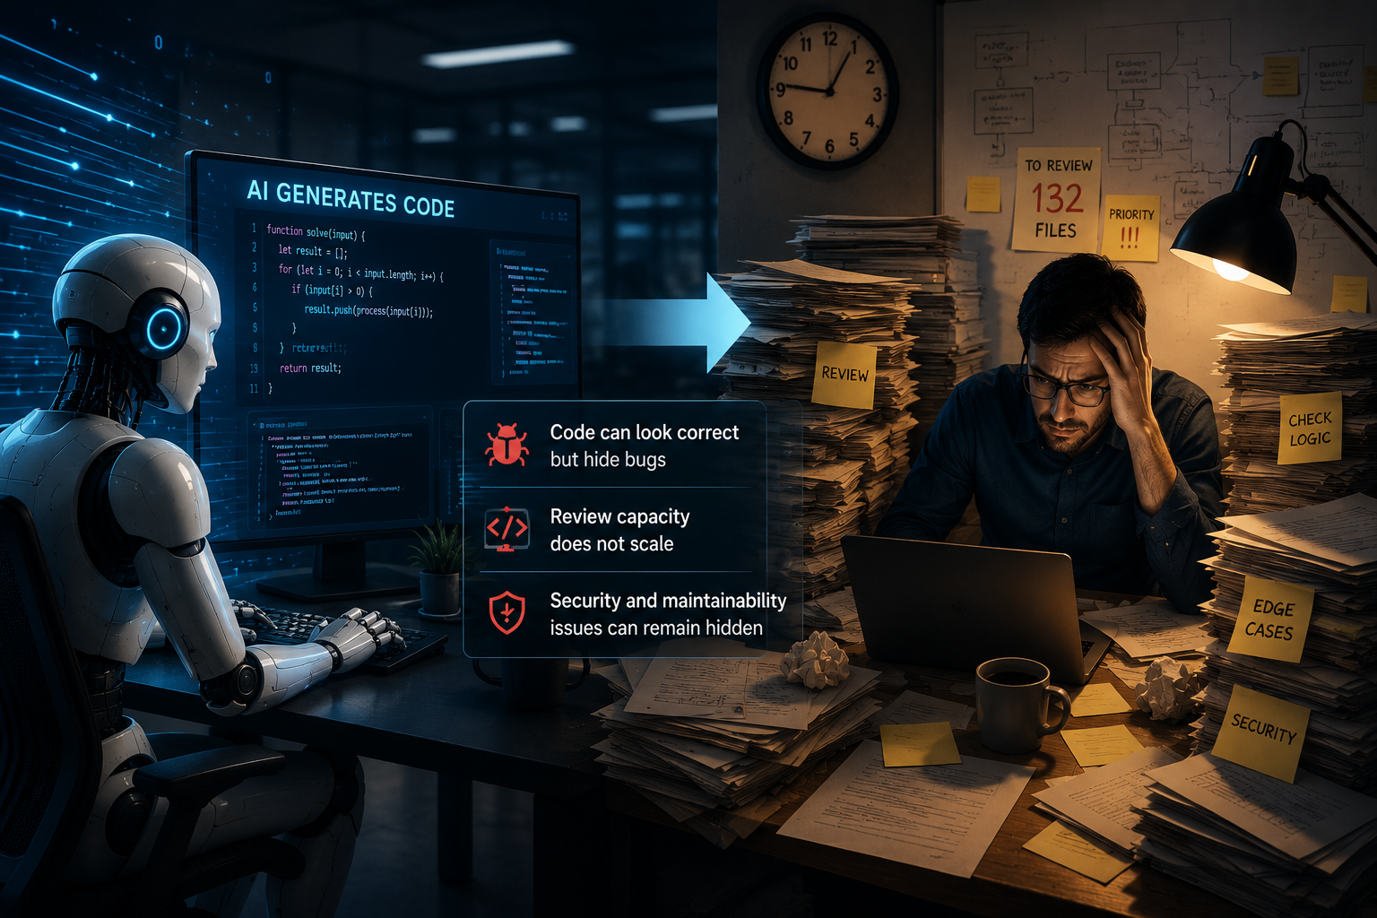
TASK 1: TWO MAIN CHALLENGES
Challenge 1 — Quality and security drift
AI-generated code may introduce:
duplicated logic
weak abstractions
higher complexity
hidden security risks
Challenge 2 — Review bottleneck
Teams can produce more code than reviewers can check.

Slide 5
TASK 2: TOOL SELECTION
Question: Which tool fits our case study?
Tool | Fit
Dependabot | Too little dependency surface
CodeQL | Strong, but mainly security-focused
Secret Protection | No secrets in project
Copilot code review | Needs PR workflow
Dependency Review | Needs PR dependency diff
SonarQube | Best fit: reliability, maintainability, hotspots

Slide 6
CASE STUDY SETUP
Element | Description
Project | ZHAW PM1 Project 3: text-based Catan
Human version | Public student implementation
AI version | Claude Opus implementation
Scope | Base game, cities extension, robber variant
Build | Java Maven project
Tool | SonarQube Community Edition
Same specification. Two implementations. One static analyser.

Slide 7
STRUCTURAL COMPARISON
The AI version was much faster and smaller.
Metric | AI | Human
Main source LOC | 1,108 | 2,718
Main files | 9 | 17
Test LOC | 260 | 2,060
Test files | 1 | 12
Test/Main ratio | 0.23 | 0.76

Slide 8
SONARQUBE RESULTS + 5 LESSONS
Metric | AI | Human
Security issues | 0 | 0
Reliability issues | 3 | 1
Maintainability issues | 16 | 9
Security hotspots | 3 | 1
Five lessons learned
Production cost and verification cost are different.
Static analysis catches some quality drift, not rule correctness.
A clean security rating may only mean the scan surface is small.
AI can concentrate complexity in core logic.
AI shifts engineering work; it does not remove responsibility.

Slide 9
ACTIVITY: CODE SHOWDOWN
You will see two working Java solutions.
Same problem.
Same Big-O complexity.
One is human-written.
One is AI-generated.
Decide which one you would trust more in production.
This matches the activity design: compare two anonymous Valid Sudoku solutions and evaluate quality, readability, and maintainability.

Slide 10
ACTIVITY PROBLEM: VALID SUDOKU
Task: Determine whether a 9×9 Sudoku board is valid.
Each row must contain digits 1–9 without repetition.
Each column must contain digits 1–9 without repetition.
Each 3×3 box must contain digits 1–9 without repetition.
Only filled cells matter. The board does not need to be solvable.

Slide 11
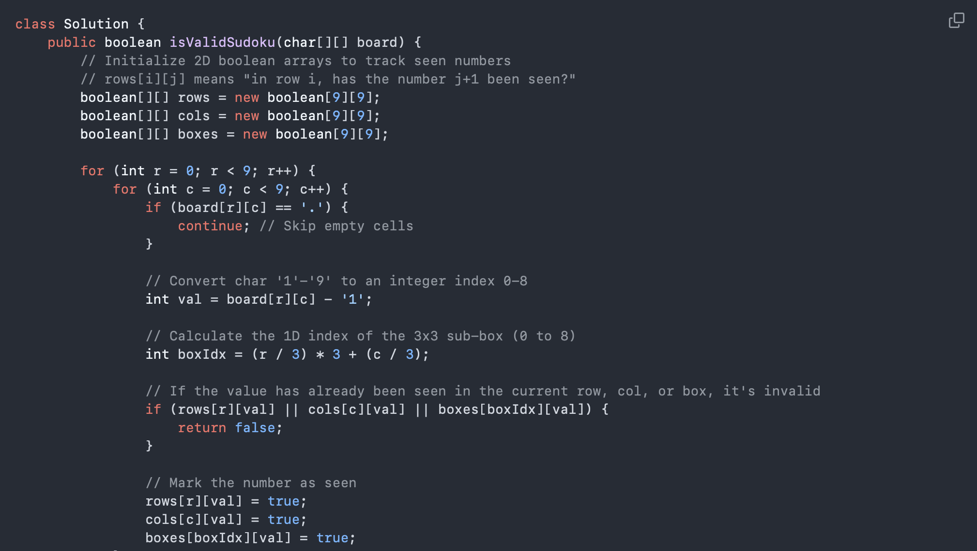
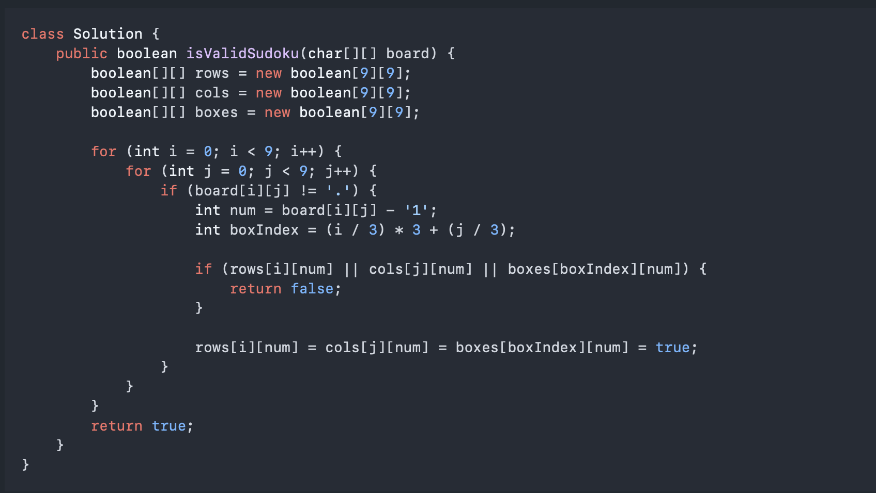
SNIPPET A VS SNIPPET B

Slide 12
REVEAL AND DEBRIEF
Snippet A = Human, competitive-programming style
Snippet B = AI, clean-code style
Both are correct. Same algorithmic complexity. But they create different review experiences.
Key connection to report: AI code may look clean, but engineers still need to review correctness, maintainability, context fit, and long-term design.

Slide 13
Q&A
Thank you for your time and attention

